Slide 1

Open Authentication 2.0
( OAuth 2.0)
By Muthuraja Learn @ Lunch Time

Slide 2
OUTLINE
Introduction
Why we need Open Authentication (OAuth) ?
OAuth ROLEs
Client Types & Profiles
Web Applications
User Agent Applications
Native Applications
Hybrid Applications
OAuth 2.0 Authentication
Client ID, Client Secret and Redirect URI
Authorization Grant
Authorization Code
Implicit
Resource Owner Password Credentials
Client Credentials
End Points
OAuth 2.0 Requests and Response
Authorization Code
Implicit
Resource Owner Password Credentials
Client Credentials
By Muthuraja Learn @ Lunch Time

Slide 3
Introduction
Why we need to secure everything?
Differences between Authentication (Vs.) Authorization
Classic way of Authentication
Drawbacks on Classic way
By Muthuraja Learn @ Lunch Time

Slide 4
What is OAuth?
What is OAuth?
OAuth (Open Authorization) is an open standard for token-based authentication and authorization on the Internet. OAuth, which is pronounced "oh-auth," allows an end user's account information to be used by third-party services, such as Facebook, without exposing the user's password.
In other word, OAuth 2.0 is an open authorization protocol which enables applications to access each others data. For instance, a game application can access a users data in the Facebook application.
OAuth 2.0 Use Cases?
OAuth 2.0 can be used either to create an application that can read user data from another application (e.g. the game in the diagram above), or an application that enables other applications to access its user data (e.g. Facebook in the example above).
OAuth 2.0 is a replacement for OAuth 1.0, which was more complicated. OAuth 1.0 involved certificates etc. OAuth 2.0 is more simple. It requires no certificates at all, just SSL / TLS.
By Muthuraja Learn @ Lunch Time

Slide 5
OAuth ROLE
Resource Owner
The resource owner is the person or application that owns the data that is to be shared. Probably person is resource owner in most common situation. The resource owner could also be an application. The OAuth 2.0 specification mentions both possibilities.
Resource Server
The resource server is the server hosting the resources. For instance, Facebook or Google is a resource server (or has a resource server).
Client Application
The client application is the application requesting access to the resources stored on the resource server. The resources, which are owned by the resource owner. A client application could be a game requesting access to a users Facebook account.
Authorization Server
The authorization server is the server authorizing the client app to access the resources of the resource owner. The authorization server and the resource server can be the same server, but it doesn't have to. The OAuth 2.0 specification does not say anything about how these two servers should communicate, if they are separate. This is an internal design decision to be made by the resource server + authorization server developers.
By Muthuraja Learn @ Lunch Time

Slide 6
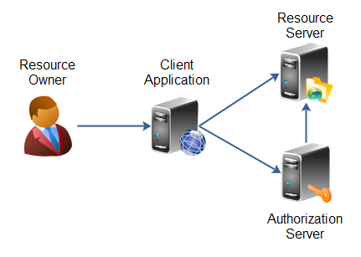
OAuth ROLE
By Muthuraja Learn @ Lunch Time

Slide 7
OAuth 2.0 Client Profiles
Client Types
Confidential
Public
Client Profiles
The OAuth 2.0 specification also mentions a set of client profiles. These profiles are concrete types of applications, that can be either confidential or public. The profiles are:
Web Application
User Agent Application
Native Application
Hybrid Applications
By Muthuraja Learn @ Lunch Time

Slide 8
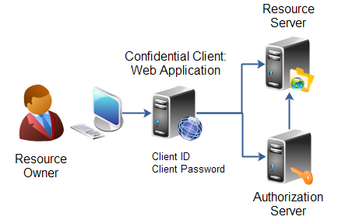
OAuth 2.0 Client Profiles
Web Application - Client Profiles
A web application is an application running on a web server. In reality, a web application typically consists of both a browser part and a server part. If a web application needs access to a resource server (e.g. to Facebook user accounts), then the client password could be stored on the server. The password would thus be confidential. Here is an illustration of a confidential client web application:
By Muthuraja Learn @ Lunch Time

Slide 9
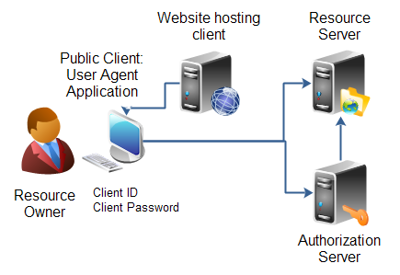
OAuth 2.0 Client Profiles
User Agent Application - Client Profiles
A user agent application is for instance a JavaScript application running in a browser. The browser is the user agent. A user agent application may be stored on a web server, but the application is only running in the user agent once downloaded. An example could be a little JavaScript game that only runs in the browser. Here is an illustration of a client user agent application:
Public client: User Agent Application.
By Muthuraja Learn @ Lunch Time

Slide 10
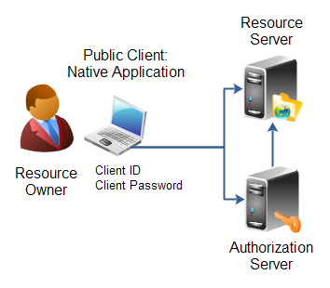
OAuth 2.0 Client Profiles
Native Application - Client Profiles
A native application is for instance a desktop application or a mobile phone application. Native applications are typically installed on the users computer or device (phone, tablet etc.). Thus, the client password will be stored on the users computer or device too. Here is an illustration of a client native application:
Public client: Native Application.
By Muthuraja Learn @ Lunch Time

Slide 11
OAuth 2.0 Client Profiles
Hybrid Applications - Client Profiles
Some applications are hybrids of these profiles. For instance, a native application can have a server part too, that does part of the work (e.g. store data). The OAuth 2.0 specification says nothing about such hybrids. However, in most cases a hybrid will be able to use the authentication models of one of these profiles.
By Muthuraja Learn @ Lunch Time

Slide 12
OAuth 2.0 Authorization
Client ID, Client Secret and Redirect URI
Before a client application can request access to resources on a resource server, the client application must first register with the authorization server associated with the resource server.
The registration is typically a one-time task. Once registered, the registration remains valid, unless the client app registration is revoked.
At registration the client application is assigned a client ID and a client secret (password) by the authorization server. The client ID and secret is unique to the client application on that authorization server. If a client application registers with multiple authorization servers (e.g. both Facebook, Twitter and Google), each authorization server will issue its own unique client ID to the client application.
Whenever the client application requests access to resources stored on that same resource server, the client application needs to authenticate itself by sending along the client ID and the client secret to the authorization server.
During the registration the client also registers a redirect URI. This redirect URI is used when a resource owner grants authorization to the client application. When a resource owner has successfully authorized the client application via the authorization server, the resource owner is redirected back to the client application, to the redirect URI.
By Muthuraja Learn @ Lunch Time

Slide 13
OAuth 2.0 Authorization
Authorization Grant
The authorization grant is given to a client application by the resource owner, in cooperation with the authorization server associated with the resource server.
The OAuth 2.0 specification lists four different types of authorization grants. Each type has different security characteristics. The authorization grant types are:
Authorization Code
Implicit
Resource Owner Password Credentials
Client Credentials
By Muthuraja Learn @ Lunch Time

Slide 14
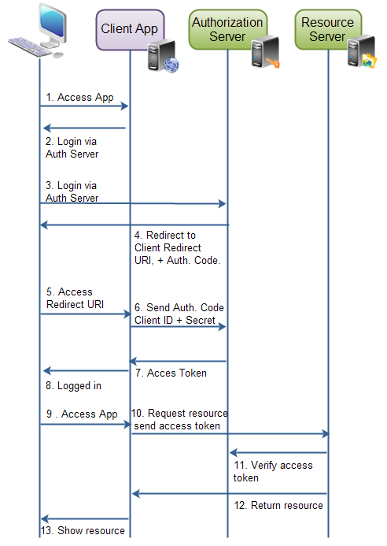
OAuth 2.0 Authorization
Authorization Code
Flow
By Muthuraja Learn @ Lunch Time

Slide 15
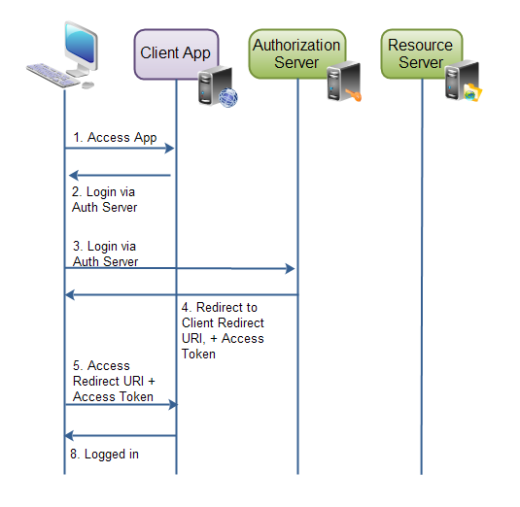
OAuth 2.0 Authorization
Implicit Flow
By Muthuraja Learn @ Lunch Time

Slide 16
OAuth 2.0 Authorization
Resource Owner Password Credentials
The resource owner password credentials authorization grant method works by giving the client application access to the resource owners credentials. For instance, a user could type his Twitter user name and password (credentials) into the client application. The client application could then use the user name and password to access resources in Twitter.
Using the resource owner password credentials requires a lot of trust in the client application. You do not want to type your credentials into an application you suspect might abuse it. The resource owner password credentials would normally be used by user agent client applications, or native client applications.
Client Credentials
Client credential authorization is for the situations where the client application needs to access resources or call functions in the resource server, which are not related to a specific resource owner
By Muthuraja Learn @ Lunch Time

Slide 17
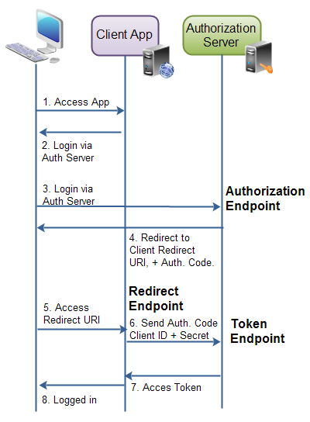
OAuth 2.0 End Points
End Points
An endpoint is typically a URI on a web server. For instance, the address of a Java servlet, JSP page, PHP page, ASP.NET page etc.
The endpoints defined are:
Authorization Endpoint
Token Endpoint
Redirection Endpoint
The authorization endpoint and token endpoint are both located on the authorization server. The redirection endpoint is located in the client application.
By Muthuraja Learn @ Lunch Time

Slide 18
OAuth 2.0 Requests and Responses
Requests and Responses
When the client application requests authorization and access tokens it sends HTTP requests to the authorization server, to its authorization and token endpoints. What request and response is sent forth and back depends on the authorization grant type. Remember, the four grant types are:
Authorization Code Grant
Implicit Grant
Resource Owner Password Credentials Grant
Client Credentials Grant
By Muthuraja Learn @ Lunch Time

Slide 19
OAuth 2.0 Authorization Code Requests and Responses
Authorization Request
The authorization code grant consists of 2 requests and 2 responses in total.
An authorization request + response, and a token request + response. The authorization request is sent to the authorization endpoint to obtain an authorization code.
Here are the parameters used in the request:
response_type | Required. Must be set to code
client_id | Required. The client identifier as assigned by the authorization server, when the client was registered.
redirect_uri | Optional. The redirect URI registered by the client.
scope | Optional. The possible scope of the request.
state | Optional(recommended). Any client state that needs to be passed on to the client request URI.
By Muthuraja Learn @ Lunch Time

Slide 20
OAuth 2.0 Authorization Code Requests and Responses
Authorization Response
The authorization response contains the authorization code needed to obtain an access token
Here are the parameters used in the request:
code | Required. The authorization code
state | Required, if present in request. The same value as sent by the client in the state parameter, if any.
By Muthuraja Learn @ Lunch Time

Slide 21
OAuth 2.0 Authorization Code Requests and Responses
Authorization Error Response
If an error occurs during authorization, two situations can occur
FIRST is that the client is not authenticated or recognized. For instance, a wrong redirect URI was sent in the request. In that case the authorization server must not redirect the resource owner to the redirect URI. Instead it should inform the resource owner of the error.
SECOND is that client is authenticated correctly, but that something else failed. In that case the following error response is sent to the client, included in the redirect URI:
error | Required. Must be one of a set of predefined error codes. See the specification for the codes and their meaning
error_description | Optional, A human-readable UTF-8 encoded text describing the error. Intended for a developer, not an end user.
error_uri | Optional, A URI pointing to a human-readable web page with information about the error.
state | Required, if present in authorization request. The same value as sent in the state parameter in the request.
By Muthuraja Learn @ Lunch Time

Slide 22
OAuth 2.0 Authorization Code Requests and Responses
Token Request
Once an authorization code is obtained, the client can use that code to obtain an access token.
Here is the access token request parameters:
client_id | Required. The client application's id.
client_secret | Required. The client application's client secret .
grant_type | Required. Must be set to authorization_code .
code | Required. The authorization code received by the authorization server.
redirect_uri | Required, if the request URI was included in the authorization request. Must be identical then.
By Muthuraja Learn @ Lunch Time

Slide 23
OAuth 2.0 Authorization Code Requests and Responses
Token Response
The response to the access token request is a JSON string containing the access token plus some more information:
{
"access_token" : "...",
"token_type" : "...",
"expires_in" : "...",
"refresh_token" : "...",
}
access_token property is the access token as assigned by the authorization server.
token_type property is a type of token assigned by the authorization server.
expires_in property is a number of seconds after which the access token expires, and is no longer valid. Expiration of access tokens is optional.
refresh_token property contains a refresh token in case the access token can expire. The refresh token is used to obtain a new access token once the one returned in this response is no longer valid.
By Muthuraja Learn @ Lunch Time

Slide 24
OAuth 2.0 Implicit Requests and Responses
Implicit Grant Request
The implicit grant request contains the following parameters:
response_type | Required. Must be set to token .
client_id | Required. The client identifier as assigned by the authorization server, when the client was registered.
redirect_uri | Optional. The redirect URI registered by the client.
scope | Optional. The possible scope of the request.
state | Optional(recommended). Any client state that needs to be passed on to the client request URI.
By Muthuraja Learn @ Lunch Time

Slide 25
OAuth 2.0 Implicit Requests and Responses
Implicit Grant Response
The implicit grant response contains the following parameters. Note, that the implicit grant response is not JSON.
access_token | Required. The access token assigned by the authorization server.
token_type | Required. The type of the token
expires_in | Recommended. A number of seconds after which the access token expires.
scope | Optional. The scope of the access token.
state | Required, if present in the authorization request. Must be same value as state parameter in request.
By Muthuraja Learn @ Lunch Time

Slide 26
OAuth 2.0 Implicit Requests and Responses
Implicit Grant Error Response
If an error occurs during authorization, two situations can occur.
The first is, that the client is not authenticated or recognized. For instance, a wrong redirect URI was sent in the request. In that case the authorization server must not redirect the resource owner to the redirect URI. Instead it should inform the resource owner of the error.
The second situation is that client is okay, but that something else happened. In that case the following error response is sent to the client, included in the redirect URI:
error | Required. Must be one of a set of predefined error codes. See the specification for the codes and their meaning.
error_description | Optional. A human-readable UTF-8 encoded text describing the error. Intended for a developer, not an end user.
error_uri | Optional. A URI pointing to a human-readable web page with information about the error.
state | Required, if present in authorization request. The same value as sent in the stateparameter in the request.
By Muthuraja Learn @ Lunch Time

Slide 27
OAuth 2.0 Resource Owner Password Credential Grant (R&R)
Resource Owner Password Credentials Grant Request
The request contains the following parameters:
grant_type | Required. Must be set to password
username | Required. The username of the resource owner, UTF-8 encoded.
password | Required. The password of the resource owner, UTF-8 encoded.
scope | Optional. The scope of the authorization.
Resource Owner Password Credentials Grant Response
The response is a JSON structure containing the access token. The JSON structure looks like this:
{
"access_token" : "...",
"token_type" : "...",
"expires_in" : "...",
"refresh_token" : "...",
}
access_token property is the access token as assigned by the authorization server.
token_type property is a type of token assigned by the authorization server.
expires_in property is a number of seconds after which the access token expires, and is no longer valid. Expiration of access tokens is optional.
refresh_token property contains a refresh token in case the access token can expire. The refresh token is used to obtain a new access token once the one returned in this response is no longer valid.
By Muthuraja Learn @ Lunch Time

Slide 28
OAuth 2.0 Client Credentials Grant Requests and Response
Client Credentials Grant Request
The client credentials grant request contains the following parameters
grant_type | Required. Must be set to client_credentials
scope | Optional. The scope of the authorization.
Client Credentials Grant Response
The client credentials response contains the following parameters
{
"access_token" : "...",
"token_type" : "...",
"expires_in" : "..."
}
access_token property is the access token as assigned by the authorization server.
token_type property is a type of token assigned by the authorization server.
expires_in property is a number of seconds after which the access token expires, and is no longer valid. Expiration of access tokens is optional.
NOTE: A refresh token should not be included for this type of authorization request.
By Muthuraja Learn @ Lunch Time

Slide 29
Any question ?
refer these sites for more clarity on OAuth 2.0 implementation
http://tutorials.jenkov.com/oauth2/index.html
https://github.com/MikeWasson/LocalAccountsApp
http://bitoftech.net/2015/01/21/asp-net-identity-2-with-asp-net-web-api-2-accounts-management/
http://www.asp.net/web-api/overview/security/individual-accounts-in-web-api
By Muthuraja Learn @ Lunch Time

Slide 30
Thank You
By Muthuraja Learn @ Lunch Time

